Slide 1

Training-Free Urban Anomaly Recognition Using Vision and Language Models
Linoy Halifa
Dr. Ezra Ella

Slide 2
Project aims
Main Aim: Develop a training-free framework for urban anomaly recognition leveraging vision–language foundation models to identify and localize abnormal urban events or objects without additional model training.
Secondary Aim: Demonstrate that existing open-source and surveillance datasets can be effectively used for anomaly detection without the need for new data collection.

Slide 3
References
Zhang, Y., Li, T., Wang, H., & Liu, X. (2025). Towards Training-Free Anomaly Detection with Vision and Language Foundation Models. In Proceedings of the IEEE/CVF Conference on Computer Vision and Pattern Recognition (CVPR 2025).
Zhou, Q., Pang, G., Tian, Y., He, S., & Chen, J. (2023). AnomalyCLIP: Object-Agnostic Prompt Learning for Zero-Shot Anomaly Detection. arXiv preprint arXiv:2310.18961.
Gu, Z., Zhu, B., Zhu, G., Chen, Y., Li, H., Tang, M., & Wang, J. (2024, October). FiLo: Zero-Shot Anomaly Detection by Fine-Grained Description and High-Quality Localization. In Proceedings of the 32nd ACM International Conference on Multimedia (pp. 2041–2049).
Ronecker, M. P., Foutter, M., Elhafsi, A., Gammelli, D., Barakaiev, I., Pavone, M., & Watzenig, D. (2025). Vision Foundation Model Embedding-Based Semantic Anomaly Detection. arXiv preprint arXiv:2505.07998.

Slide 4
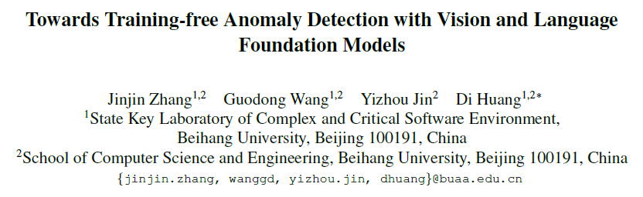
Main article
Aims
Propose a training-free framework for anomaly detection using large vision–language foundation models (VLMs).
Eliminate the need for dataset-specific fine-tuning while maintaining high detection accuracy.
Leverage the semantic understanding of VLMs (e.g., CLIP, ALIGN) to detect anomalies from open-world categories.
Methods
Uses frozen VLMs to extract multi-modal features from both images and textual anomaly descriptions.
Introduces semantic context alignment, mapping normal vs. abnormal cues via text prompts.
Employs region-based visual reasoning for localizing anomalies without pixel-level supervision.
Introduces a text-guided similarity scoring method to identify anomalies directly from embeddings.
Key Achievements
Achieved state-of-the-art performance among training-free anomaly detection methods.
Demonstrated strong generalization across multiple industrial and natural image datasets.
Reduced computation and data requirements - no retraining, only prompt engineering.
Showed that language guidance enhances anomaly localization and explainability.
Validated scalability of foundation models for open-set visual anomaly detection.

Slide 5
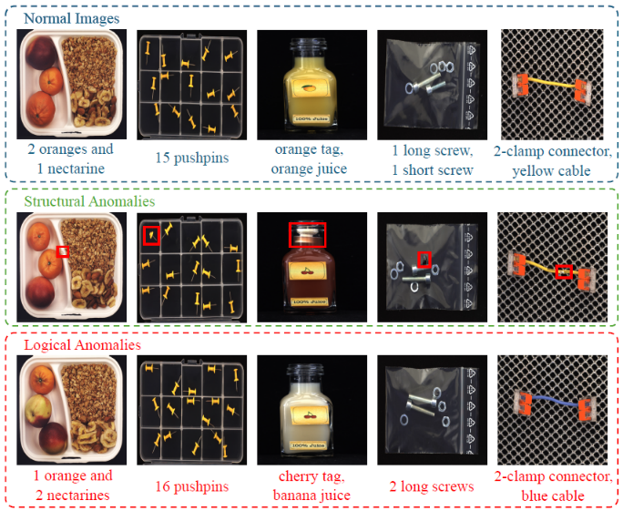
Main article
Aims
Propose a training-free framework for anomaly detection using large vision–language foundation models (VLMs).
Eliminate the need for dataset-specific fine-tuning while maintaining high detection accuracy.
Leverage the semantic understanding of VLMs (e.g., CLIP, ALIGN) to detect anomalies from open-world categories.
Methods
Uses frozen VLMs to extract multi-modal features from both images and textual anomaly descriptions.
Introduces semantic context alignment, mapping normal vs. abnormal cues via text prompts.
Employs region-based visual reasoning for localizing anomalies without pixel-level supervision.
Introduces a text-guided similarity scoring method to identify anomalies directly from embeddings.
Key Achievements
Achieved state-of-the-art performance among training-free anomaly detection methods.
Demonstrated strong generalization across multiple industrial and natural image datasets.
Reduced computation and data requirements — no retraining, only prompt engineering.
Showed that language guidance enhances anomaly localization and explainability.
Validated scalability of foundation models for open-set visual anomaly detection.

Slide 6
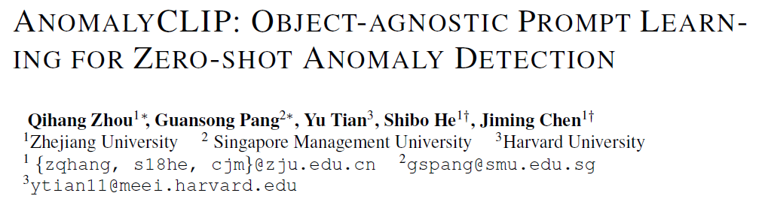
Aims:
Enable zero-shot anomaly detection without requiring training on specific objects or anomaly types.
Overcome object-specific bias in CLIP-based methods by introducing an object-agnostic approach.
Methods:
Built upon CLIP (Contrastive Language–Image Pretraining) for joint vision–language understanding.
Introduced Object-Agnostic Prompt Learning OAPL that learns general “normal” vs “abnormal” prompts.
Used region-level feature extraction and attention-based localization to identify anomaly areas.
Kept CLIP encoders frozen; only optimized lightweight textual prompts.
Key Achievements:
First framework achieving object-agnostic zero-shot anomaly detection using CLIP.
State-of-the-art results on MVTec-AD and VisA benchmarks.
Strong cross-dataset generalization - no retraining needed.
Provided explainable attention maps highlighting anomalies.
Demonstrated how language-based prompts improve anomaly reasoning and localization.

Slide 7
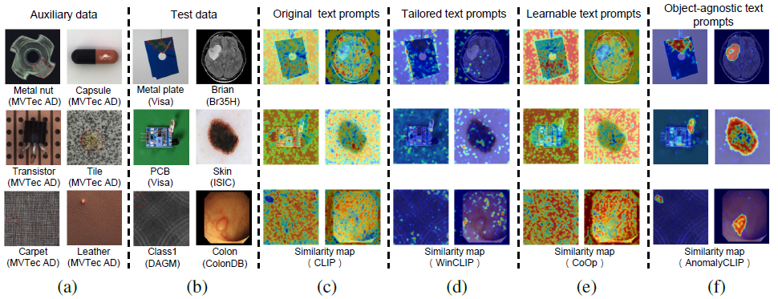
Aims:
Enable zero-shot anomaly detection without requiring training on specific objects or anomaly types.
Overcome object-specific bias in CLIP-based methods by introducing an object-agnostic approach.
Methods:
Built upon CLIP (Contrastive Language–Image Pretraining) for joint vision–language understanding.
Introduced Object-Agnostic Prompt Learning (OAPL) that learns general “normal” vs “abnormal” prompts.
Used region-level feature extraction and attention-based localization to identify anomaly areas.
Kept CLIP encoders frozen; only optimized lightweight textual prompts.
Key Achievements:
First framework achieving object-agnostic zero-shot anomaly detection using CLIP.
State-of-the-art results on MVTec-AD and VisA benchmarks.
Strong cross-dataset generalization - no retraining needed.
Provided explainable attention maps highlighting anomalies.
Demonstrated how language-based prompts improve anomaly reasoning and localization.

Slide 8
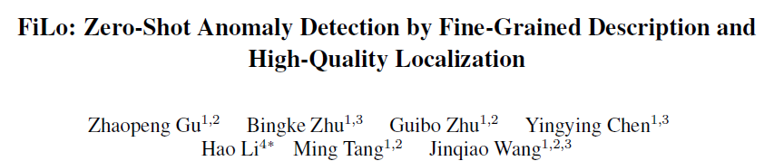
Aim
Improve zero-shot anomaly detection by enabling fine-grained description and accurate localization.
Leverage multimodal reasoning to detect subtle and complex anomalies without training on anomalies.
Methods
Combines visual features from pretrained vision models with detailed textual prompts.
Introduces a fine-grained description module that decomposes anomalies into descriptive attributes.
Employs high-quality localization using feature-level similarity between normal and abnormal regions.
Uses a prompt refinement process to better align textual and visual embeddings for different scenes.
Key Achievements
Achieved high localization precision and strong cross-dataset generalization in zero-shot settings.
Outperformed prior CLIP-based anomaly detection approaches on multiple benchmarks.
Demonstrated robustness in identifying small, subtle, and multi-type anomalies.
Provided interpretable results through text–image correspondence and localized heatmaps.
Showed that fine-grained textual guidance significantly enhances semantic anomaly understanding.

Slide 9
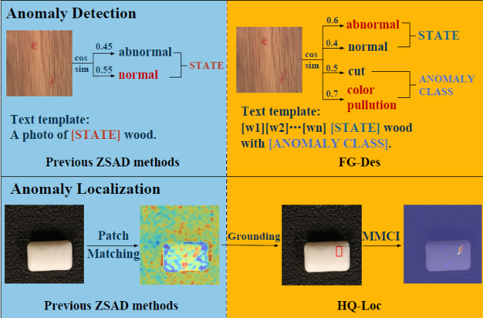
Aim
Improve zero-shot anomaly detection by enabling fine-grained description and accurate localization.
Leverage multimodal reasoning to detect subtle and complex anomalies without training on anomalies.
Methods
Combines visual features from pretrained vision models with detailed textual prompts.
Introduces a fine-grained description module that decomposes anomalies into descriptive attributes.
Employs high-quality localization using feature-level similarity between normal and abnormal regions.
Uses a prompt refinement process to better align textual and visual embeddings for different scenes.
Key Achievements
Achieved high localization precision and strong cross-dataset generalization in zero-shot settings.
Outperformed prior CLIP-based anomaly detection approaches on multiple benchmarks.
Demonstrated robustness in identifying small, subtle, and multi-type anomalies.
Provided interpretable results through text–image correspondence and localized heatmaps.
Showed that fine-grained textual guidance significantly enhances semantic anomaly understanding.

Slide 10
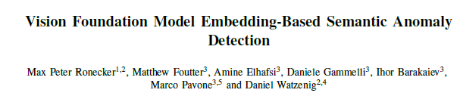
Aim
Propose a semantic anomaly detection framework using embeddings from vision foundation models.
Detect anomalies at a conceptual level rather than relying on pixel-wise differences.
Utilize foundation models’ generalization power for unseen categories and open-world conditions.
Methods
Extracts high-level semantic embeddings from pretrained vision foundation models.
Measures embedding deviations from normal samples to identify anomalies.
Employs semantic clustering and distance metrics for both global and local anomaly detection.
Uses no fine-tuning, embedding-based inference with frozen model weights.
Key Achievements
Introduced a fully semantic approach for anomaly detection using foundation model embeddings.
Achieved strong generalization and robustness across diverse visual domains.
Provided interpretable anomaly maps through embedding-space visualization.
Demonstrated competitive results without retraining or prompt engineering.
Highlighted the potential of embedding-based reasoning as a scalable solution for anomaly detection.

Slide 11

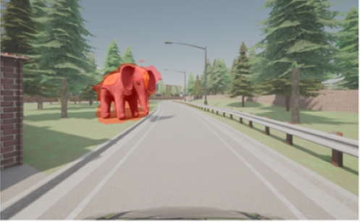
Aim
Propose a semantic anomaly detection framework using embeddings from vision foundation models.
Detect anomalies at a conceptual level rather than relying on pixel-wise differences.
Utilize foundation models’ generalization power for unseen categories and open-world conditions.
Methods
Extracts high-level semantic embeddings from pretrained vision foundation models.
Measures embedding deviations from normal samples to identify anomalies.
Employs semantic clustering and distance metrics for both global and local anomaly detection.
Uses no fine-tuning — purely embedding-based inference with frozen model weights.
Key Achievements
Introduced a fully semantic approach for anomaly detection using foundation model embeddings.
Achieved strong generalization and robustness across diverse visual domains.
Provided interpretable anomaly maps through embedding-space visualization.
Demonstrated competitive results without retraining or prompt engineering.
Highlighted the potential of embedding-based reasoning as a scalable solution for anomaly detection.

Slide 12
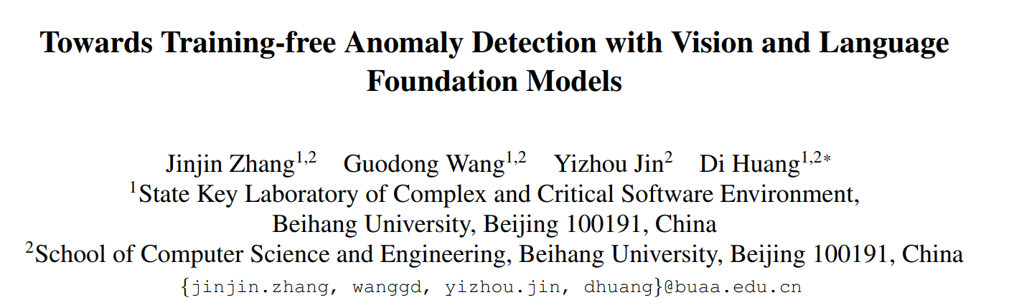
Methodology

Slide 13
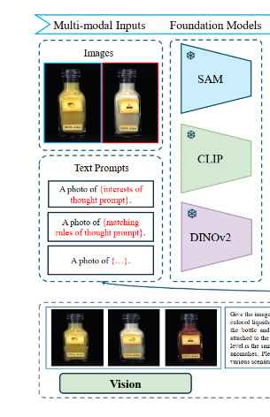
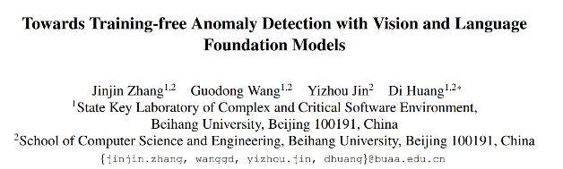
Methodology

Slide 14
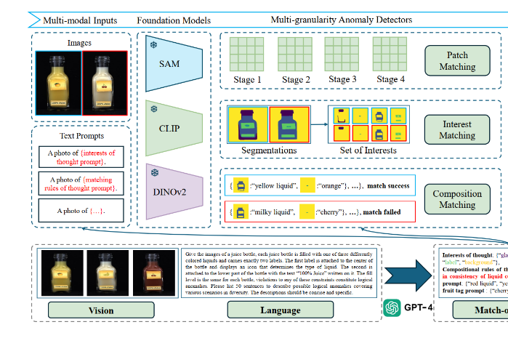
Methodology

Slide 15
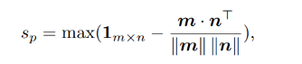
Methodology

Slide 16
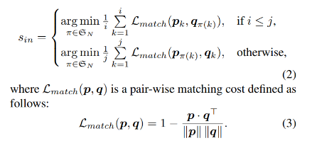
Methodology

Slide 17

Methodology

Slide 18
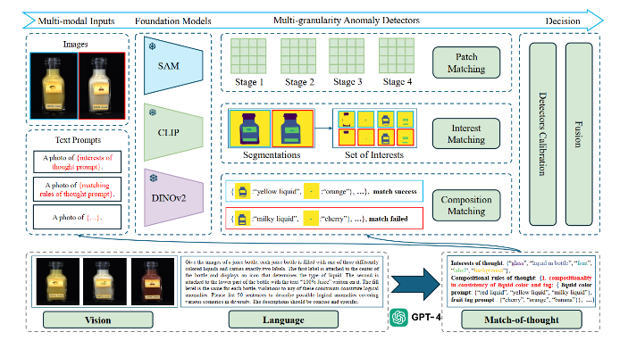
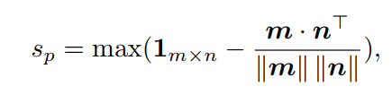
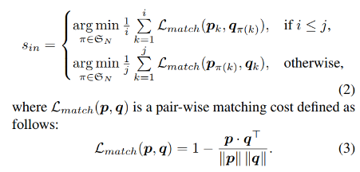

Methodology

Slide 19

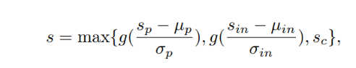
Methodology

Slide 20
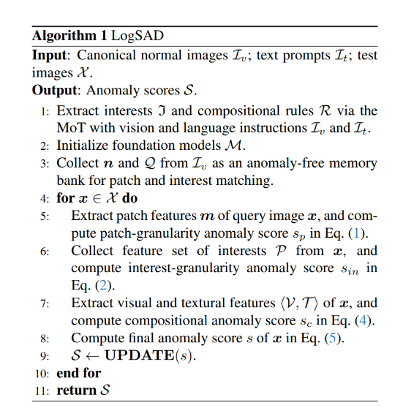
The Algo

Slide 21
Datasets

Slide 22

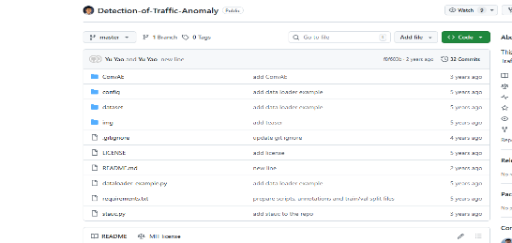
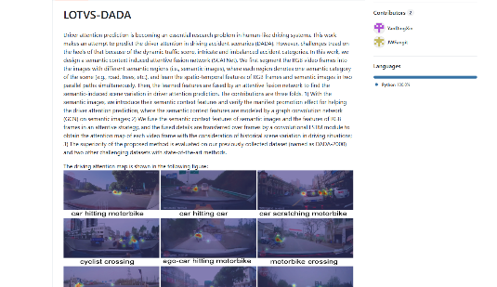

General large-scale urban driving (normal + risky, huge scale)

Slide 23



General large-scale urban driving (normal + risky, huge scale)

Slide 24
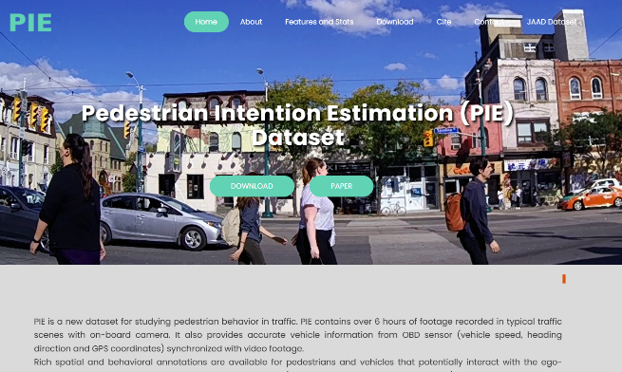
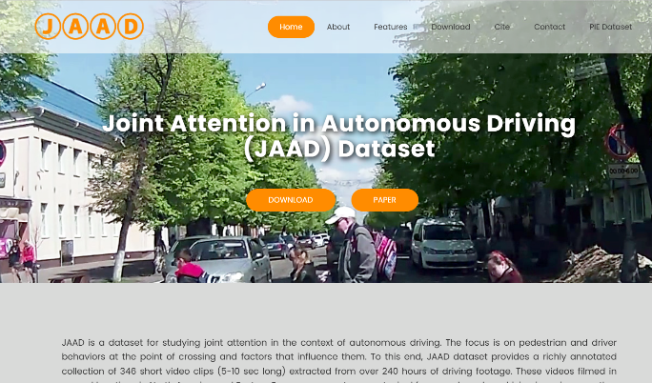
Pedestrian / behavior-oriented urban risk datasets

Slide 25
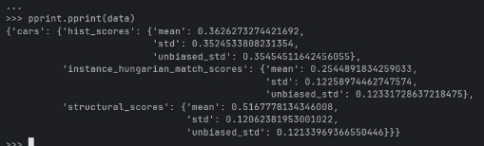
Our strategy
Tech transfer: try articles code to detect anomalies in the city
Our model with knowledge bank
Zero-shot model
Low accuracy / detection

Slide 26
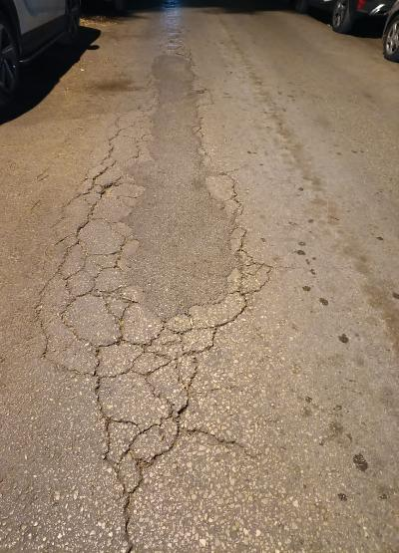
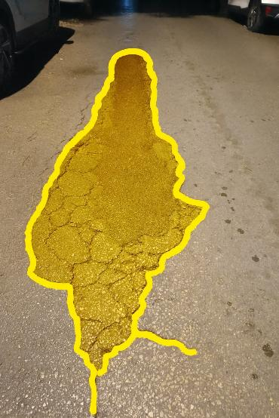
The future is already here, it's just not evenly distributed William Gibson
**The image contains a single major anomaly—severe longitudinal alligator-type road cracking along the center of the lane—which I score as Anomaly Severity: 7/10 and Risk to road users: 6/10 (moderate risk for bicycles/scooters, low–moderate for cars).

Slide 27
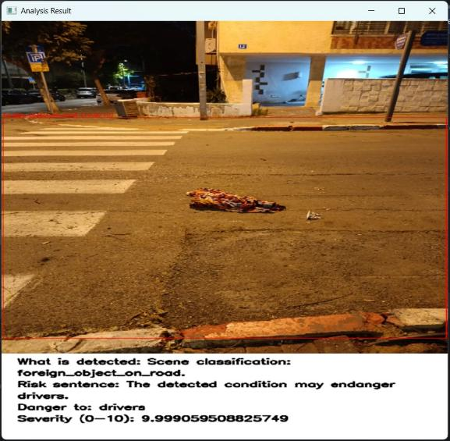

Slide 28
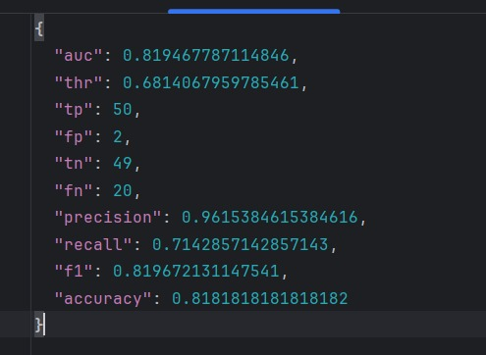
Results - metrics

Slide 29
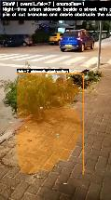
Zero-shot architecture
Local data processing
Analysis with GPT5.1
Results local analysis and alignment

Slide 30
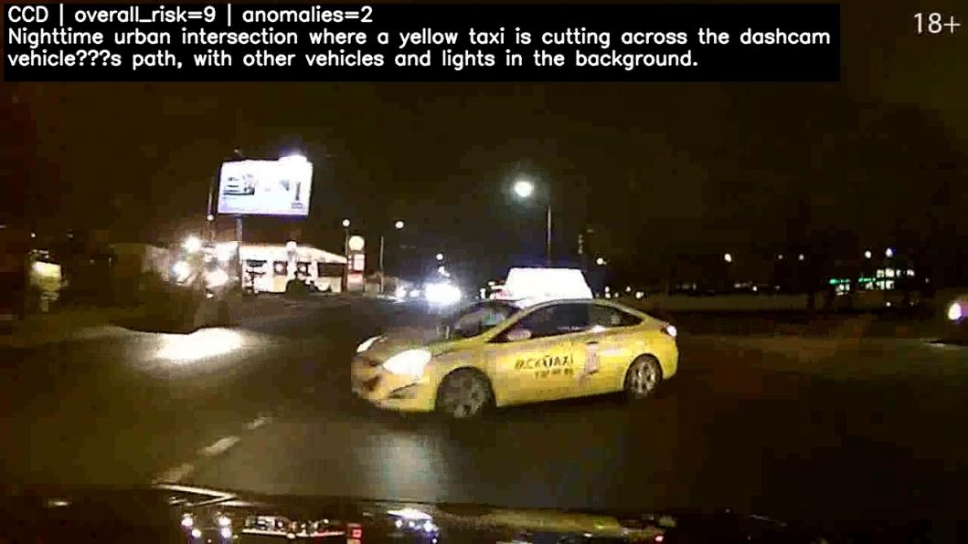
Results - Road: Complex situation crash prediction

Slide 31
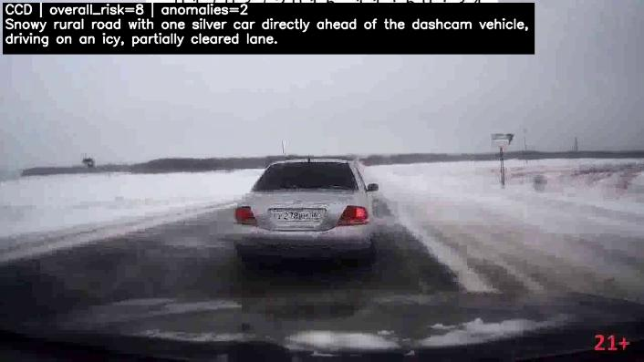
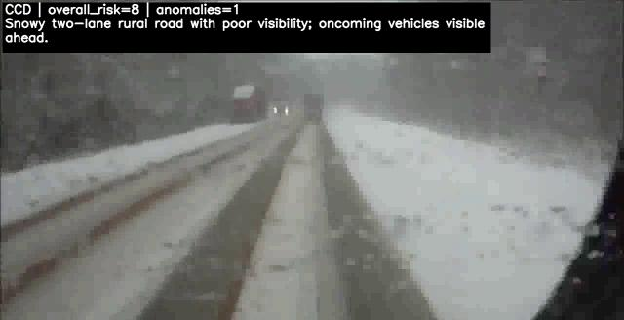
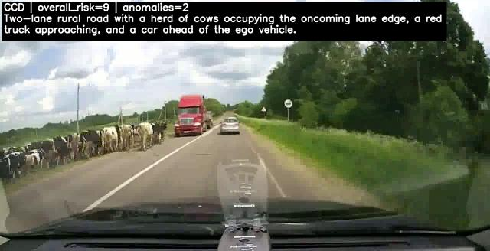
Road: different situations understanding
Icy road
Visibility
Cows

Slide 32
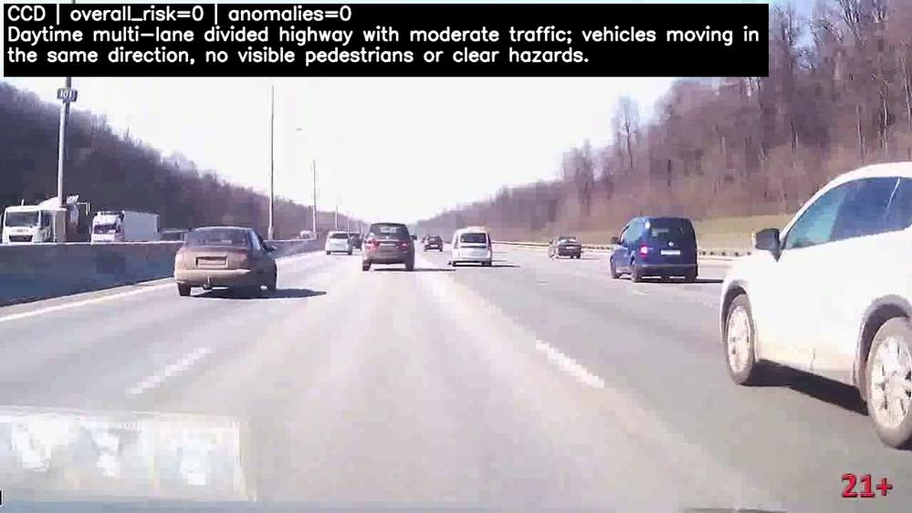
Road: Normal is normal

Slide 33
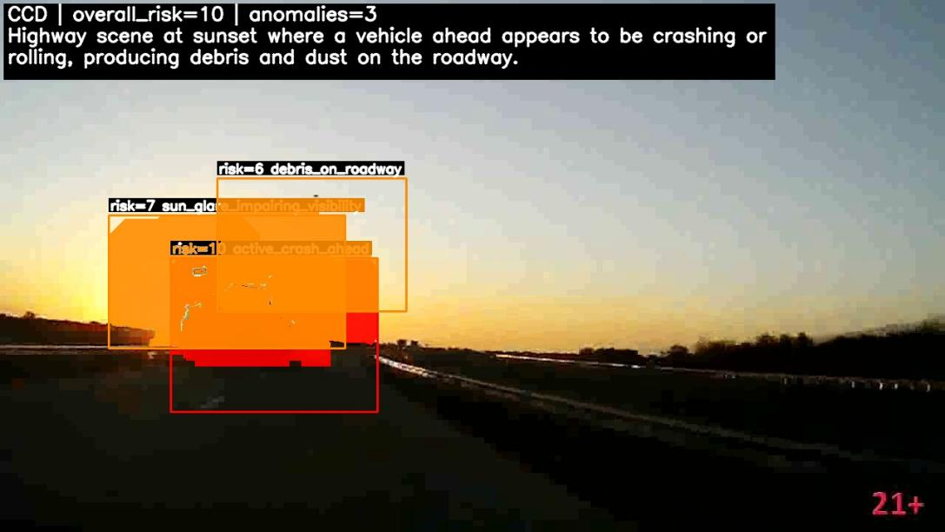
What is anomaly?

Slide 34
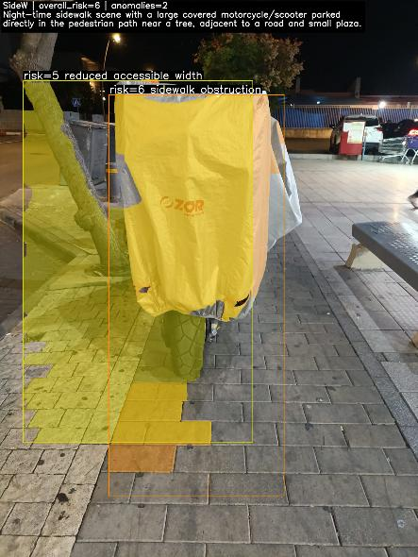
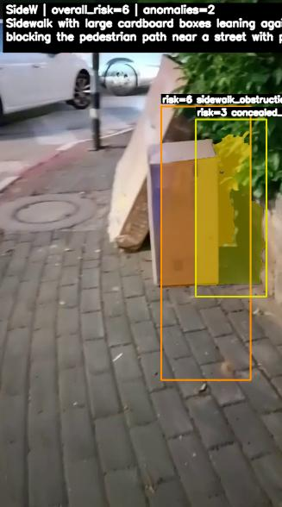
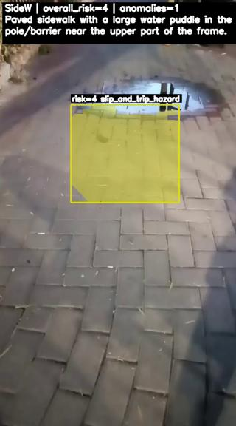
Zero shot is compatible with sidewalk scenes

Slide 35
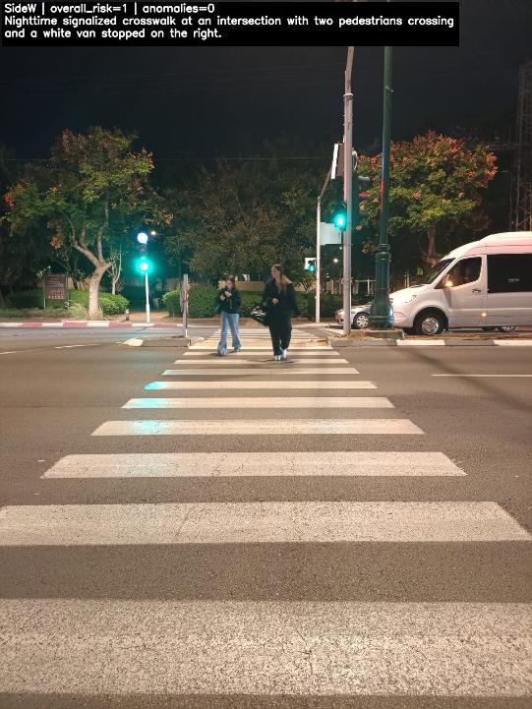
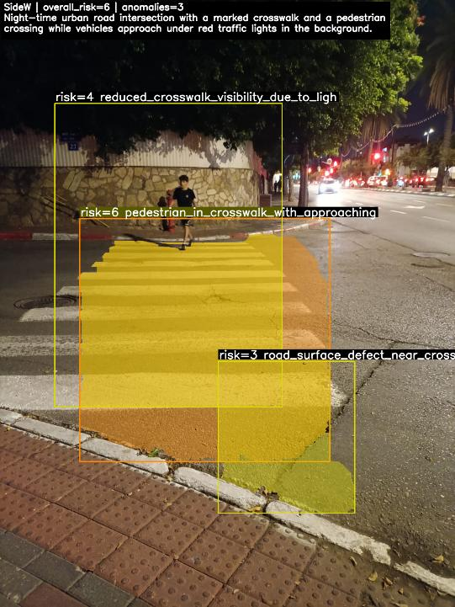

Slide 36
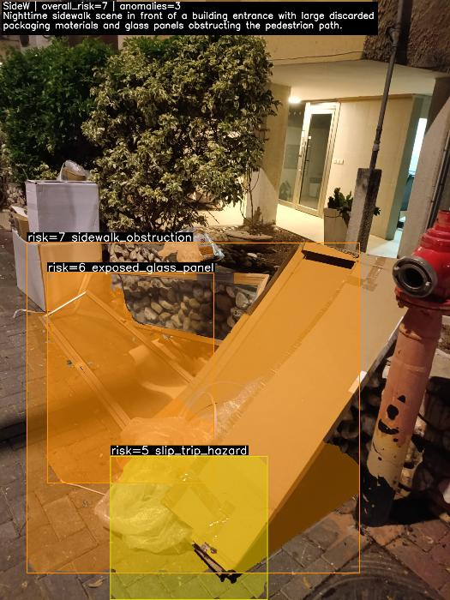

Slide 37

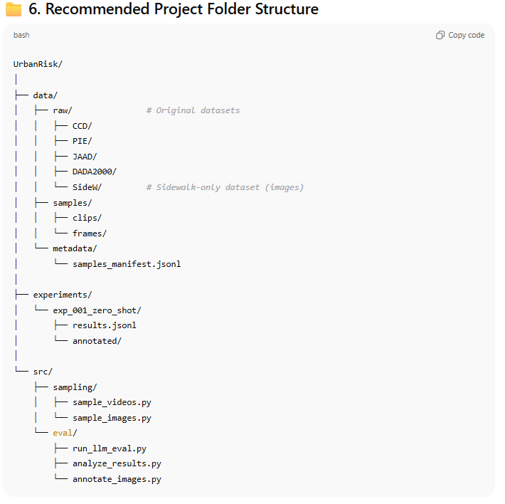

Slide 38
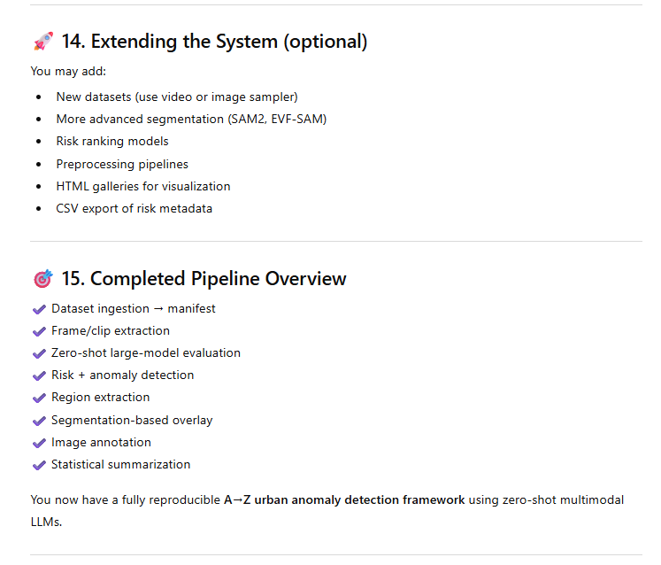
Optional future work and overview

Slide 39

Publishing
Can we compare scores where our judgment fails?

